Slide 1
html tags
MCNDHS
Ms. Eng

Slide 2
aim: forms
Do now:
Daily Grade:
On-time/attendance/not leaving the classroom: 25%
Cellphones: 25%
Notes:25%
Classwork/Homework: 25%

Slide 3
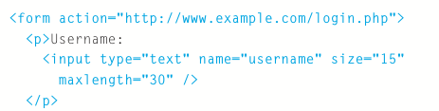
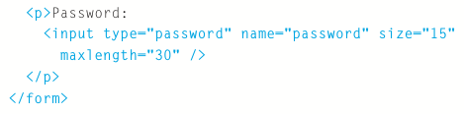
forms
Username:
Password:

Slide 4
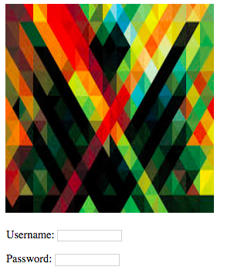
activity

